Slide 1
Escape Game
What is an escape game

Slide 2
Table of contents
Presentation
What is an escape game?
History
Where are escape games ?
What are inspirations of escape game
The bitcoin heist
Conclusion

Slide 3
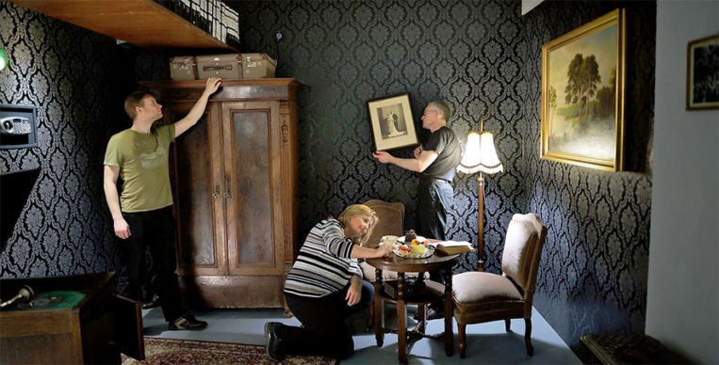


Presentation
Escape room
Physical adventure game
Solve puzzles and riddles
Often fictional locations
Lock room
Working out the clues
3-5 players or more
60 minutes
Game master
In France : +7 000 000 players
98% satisfaction
Diversified scenery
Start to grow

Slide 4
History
Basic gameplay mechanism
Video Game : “Escape Room”
Solve riddles interacting with his surroundings
The first : “Crimson Room” ; 2004 ; Toshimitsu Takagi
Japanese company : SCRAP; 2007 ; first live rooms escape
Evolve in theme room
Solve enigma in a defined time

Slide 5

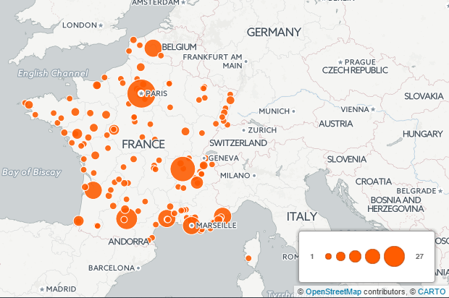
Where are escape games ?
All the world
Many in europe

Slide 6

What are inspirations of escape game
Inspired by :
Roleplay games in full-scale
Treasure hunt for find clues
Book and films
Incarnate a character
Understand the story
Your inspiration
Lock Academy : own universe (apprentice detective)
Asia vs Europe :
Dissimilarity
Asia : oriented to the competition
Europe : oriented to the immersion

Slide 7
THE BITCOIN HEIST

Slide 8
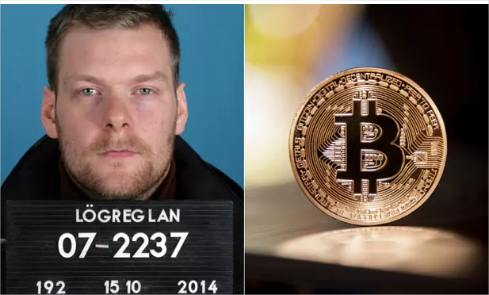


Real story and plot
Real story: man use 600 computers in Iceland to mine bitcoin
Ilegal mining : stolen computers
£1.45M of computers (pound sterling)
Movie
Escape game
- crypto money : bitcoin
60 minutes
Into a hideout of one of the hackers
Find clues about hack
Escape room in Skopje, Macedonia
2- 5 people, 40 eur per group (33 eur for 2 players)
Difficulty : hard
Language : english

Slide 9

Conclusion
60 minutes
From 1 to 5 players
In development in the world
can be educational

